Slide 1
Click to add your title (Max 3 lines)
X. Y. Name¹, X. Y. Name²
¹affiliation​
²affiliation
Your Logo

Slide 2
Basic Recommendations
All presentations must be made using Microsoft PowerPoint (Highly recommended to follow RaSiM 11 PPT Template).
The slide title font size should be 36 pt.
Use the 16:9 slide format in landscape view.
Font size should be 24 pt or bigger. Use simple fonts like Aptos, Arial, Calibri, or Verdana.
Choose colors with strong contrast so text is easy to read.
Use bullet points to keep slides short and clear.
Add visuals like graphs, pictures, and charts to help explain your points.
Don’t use pictures as slide backgrounds if you’re putting text on top.
Make sure all images and graphics are high quality 300 pixels per inch is best.
If you use an Apple computer with Keynote, save your slides as a PDF file.
If you don’t want a slide to be shared, write “Photos not allowed” on it.
Keep an eye on the time and make sure you finish your talk on time (15 minutes on presentation and 5 minutes for questions).
Presentation date
Your Logo

Slide 3
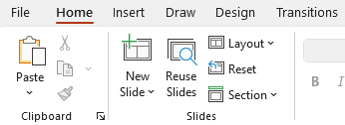
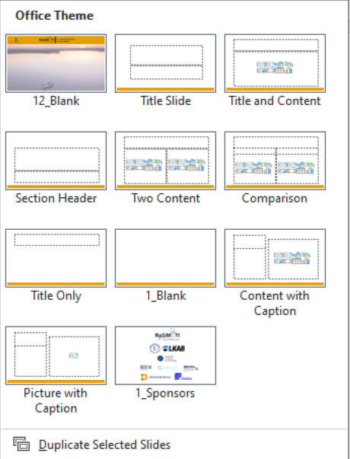
Adding new slides
Select Home option
Select new slide and add according to your preference
Presentation date
Your Logo

Slide 4
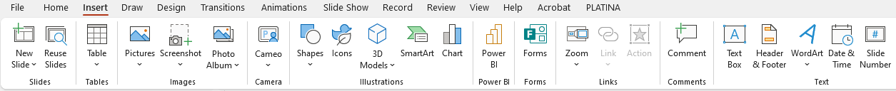
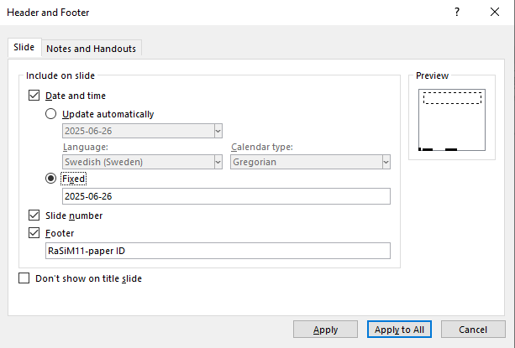
Adding presentation date and paper ID
Select Insert option
Select Header and Footer
Select Date and time
Select Fixed and fill your presentation date
Select Footer and place your Rasim paper submission ID. Example: RaSiM11-XXX
Then select apply to all, it will be updated on every slide
Your Logo

